Slide 1
Lecture 9 Mesh Analysis

Slide 2
Mesh Analysis
Mesh analysis provides another general procedure for analyzing circuits, using mesh currents as the circuit variables.
Using mesh currents instead of element currents as circuit variables is convenient and reduces the number of equations that must be solved simultaneously.
Loop is a closed path with no node passed more than once.
A mesh is a loop that does not contain any other loop within it.

Slide 3
Mesh Analysis
Steps to Determine Mesh Currents:
1. Assign mesh currents i₁, i₂, .....i_{n} to the n meshes.
2. Apply KVL to each of the n meshes. Use Ohm’s law to express the voltages in terms of the mesh currents.
3. Solve the resulting n simultaneous equations to get the mesh
currents.

Slide 4
Paths abefa and bcdeb are meshes, but path abcdefa is not a mesh.
The first step requires that mesh currents (assumed) are assigned to meshes
Apply KVL. For mesh 1,
For mesh 2,

Slide 5
The third step is to solve for the mesh currents. We are at liberty to use any technique for solving the simultaneous equations.
It can be solved to obtain the mesh currents i₁ and i₂
To distinguish between the two types of currents, we use i for a mesh current and I for a branch current.
Note: If mesh currents sign is positive, our assumed current direction is correct. Otherwise actual mesh current flowing in opposite direction.

Slide 6
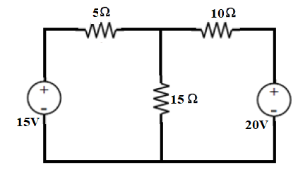
For the circuit in figure, find the mesh currents using mesh analysis.
We first obtain the mesh currents using KVL. For mesh 1,
For mesh 2,
Solve two equation, we get

Slide 7
For the circuit in figure, find the mesh currents and current I using mesh analysis.
We first obtain the mesh currents using KVL. For mesh 1,
For mesh 2,
For mesh 3,

Slide 8
Solve three equation, we get

Slide 9
Mesh Analysis with current sources
Applying mesh analysis to circuits containing current sources (dependent or independent) may appear complicated. The presence of the current sources reduces the number of equations
When a current source exists only in one mesh: That assumed mesh current is equal to that current source value and the sign of that mesh current depends upon the direction of source current.
When a current source exists between two meshes: We create a supermesh by excluding the current source and any elements connected in series with it.

Slide 10
For the circuit in figure, find the mesh currents and voltage drop across 1Ω resistor using mesh analysis.
Current source exists only in one mesh. Direction of assumed current and current source direction are same. For mesh 1,
For mesh 2,

Slide 11
For mesh 3,
For mesh 4,
Solve three equation, we get

Slide 12
Voltage drop across 1Ω resistor

Slide 13
References: Charles K. Alexander and Matthew N. O. Sadiku, “ Fundamentals of Electric circuits” McGraw-Hill Science Engineering ,5th edition,2012 Solving equation in Scientific calculator : https://www.youtube.com/watch?v=YnToAojliO4

Slide 14
Thank You

